Slide 1
G2M Cab Insights
rein Umeya

Slide 2
Goals
The goal of this analysis is to determine which of the Yellow and Pink cab’s are a better investment.
We use data from the two companies taken from 2016 to 2018 in the US.

Slide 3
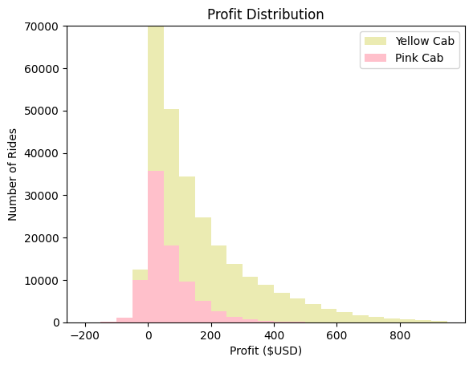
Comparing Yellow and Pink Cab profits Per Ride from 2016-2018
Analysis of profit distribution via bin size of USD $50 reveals greater profits for the yellow cab.
Mean ride profit was $160 vs $62 for yellow and pink cabs respectively.

Slide 4
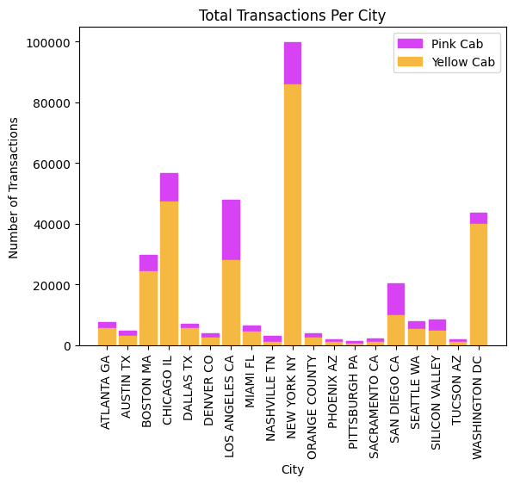
Cab Preference Across Cities
Across most of the cities where data was collected, the yellow cab is visibly preferred.
LA, Nashville, Sacramento, Pittsburgh, and San Diego present possibly opportunities for investment in the pink cab., though even in these cities the preference across the two cabs is comparable.

Slide 5
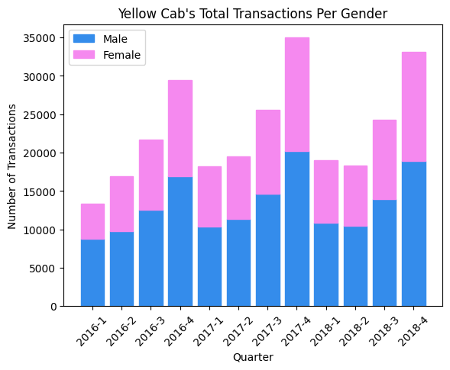
Is there differentiable preference across gender (Yellow cab)?
Across quarters we see no appreciable preference for the yellow cab across gender, though males tend to make slightly greater transactions.
In the first quarter of 2016 however we see males made more transactions.

Slide 6
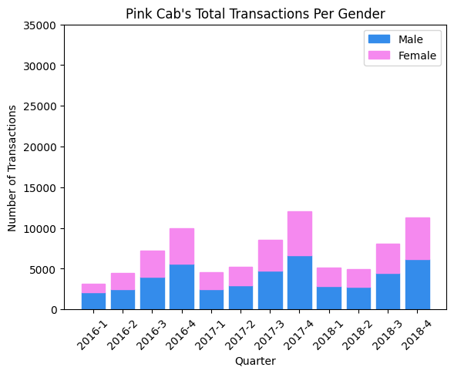
Is there differentiable preference across gender (Pink Cab)?
With the exception of the first quarter of 2016, where it appears males made more transactions, we see no differential preference for the pink cab across gender.
We observe a much lesser pink cab usage for each gender and during each quarter compared to the yellow cab.

Slide 7
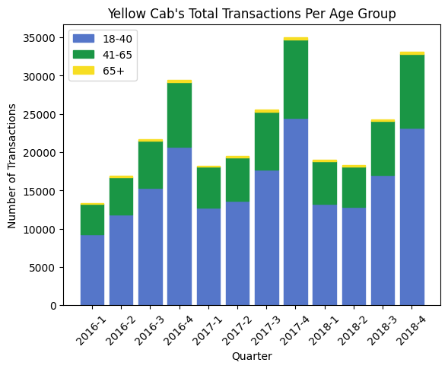
Age group analysis (Yellow Cab)
Transactions are highest in the 18-45 age group in each quarter, and almost non-existent for seniors.

Slide 8
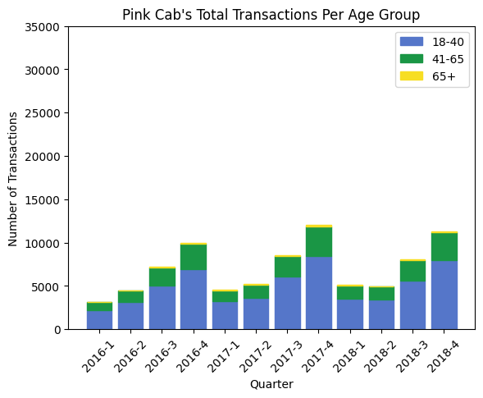
Age Group Analysis (Pink Cab)
Transactions are highest in the 18-45 age group, and again almost non-existent for seniors.
Across all quarters and age groups, transaction count is lower for pink cabs.

Slide 9
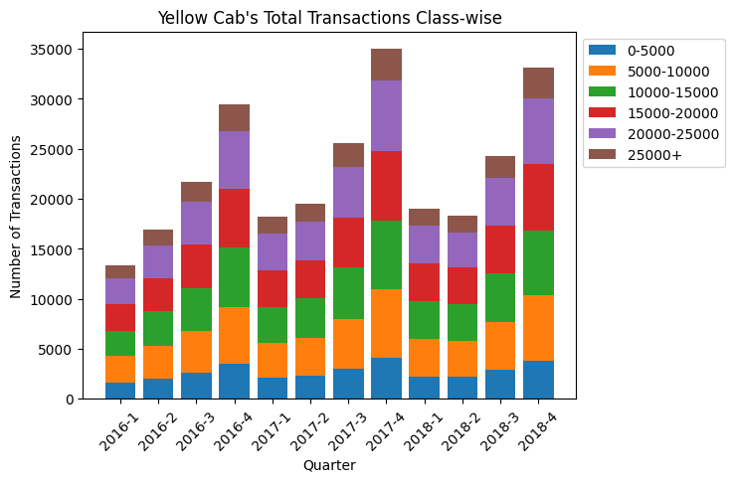
Salary group analysis (Yellow Cab)
Transactions are roughly uniformly distributed across the $5000-$25000 monthly income classes with the other two classes being the lowest.

Slide 10
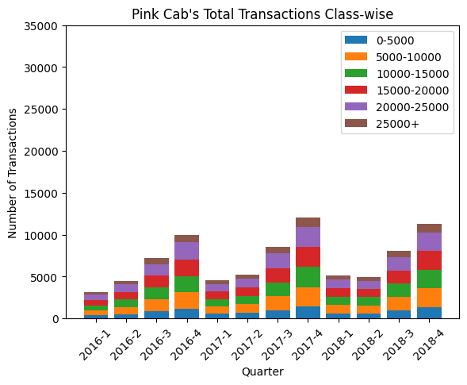
Salary group analysis (Pink Cab)
Transactions are roughly uniformly distributed across the $5000-$25000 monthly income classes with the other two classes being the lowest.
We notice when analyzing transactions across gender, age, and here salary that the count increases throughout the quarters., with the yellow cabs consistently doing better.

Slide 11
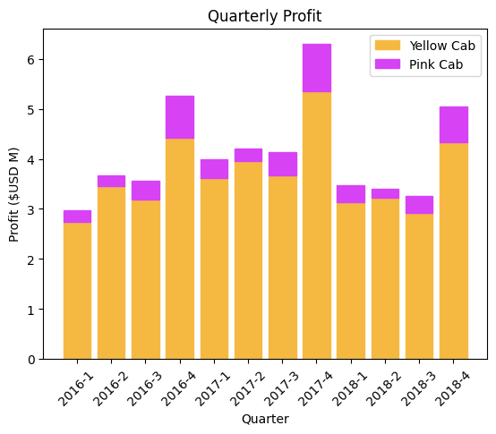
Profit analysis
In each quarter, the yellow cab generates substantially more profit.

Slide 12
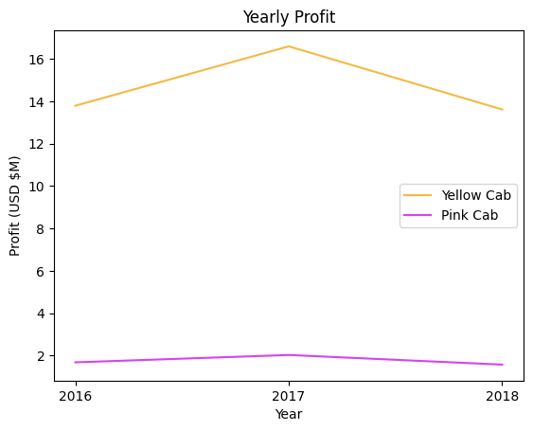
Yearly profits
Both companies had their highest profits in 2017, with the yellow cab being consistently higher.

Slide 13
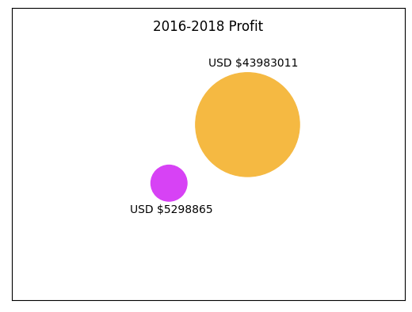
Total Profit (2016-2018)
Yellow cabs achieved over 8 times a greater profit than pink cabs.

Slide 14
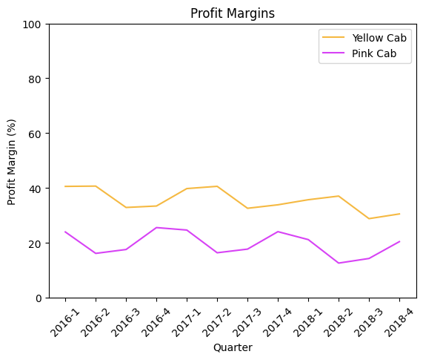
Profit Margin Analysis
Yellow cabs yield higher profit margins throughout each quarter, with an expected profit margin of 35%, and 20% for the pink cabs.
For the pink cabs, margins are highest in the first and last quarters,
For the yellow cabs, margins are highest during the first two quarters.

Slide 15
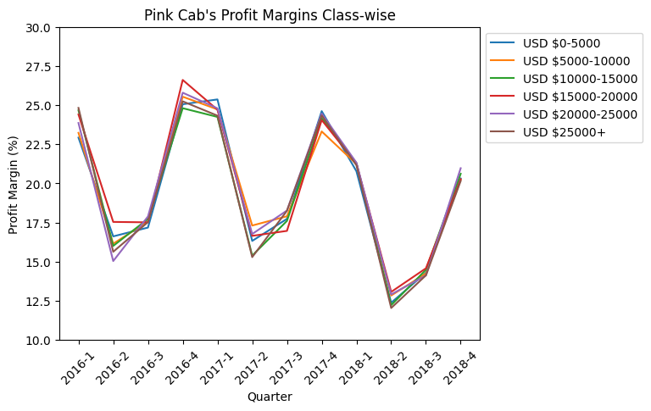
Profit Margin Analysis Class Wise (Pink Cab)
Profit margins seem to be independent of salary.

Slide 16
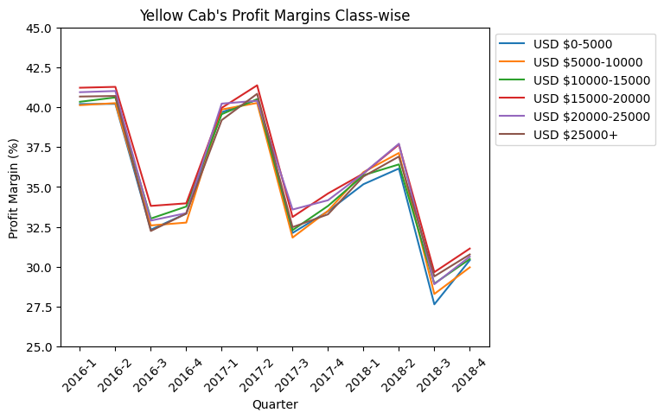
Profit Margin Analysis Class Wise (Yellow Cab)
Profit margins seem to be independent of salary.

Slide 17
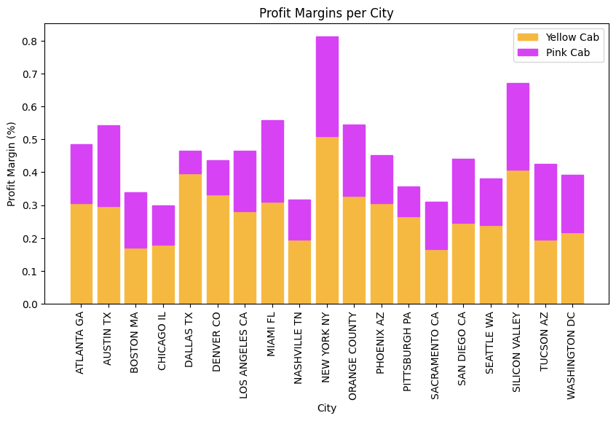
City –wise Profit Margins
Yellow cab company maintains higher profit margins across most cities.
Margins are comparable in Boston, Miami, Sacramento and Tucson.

Slide 18
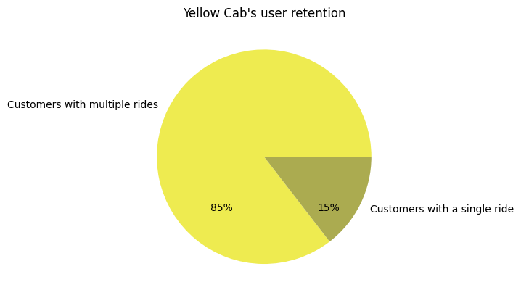
User Retention (Yellow Cab)
85% of transactions to the yellow cabs were from recurring customers.

Slide 19
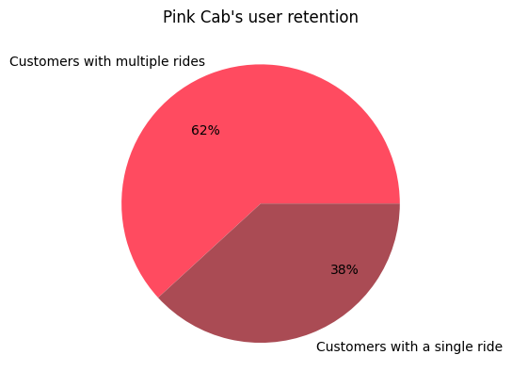
User Retention (Pink Cab)
62% of transactions to the pink cabs were from recurring customers.

Slide 20
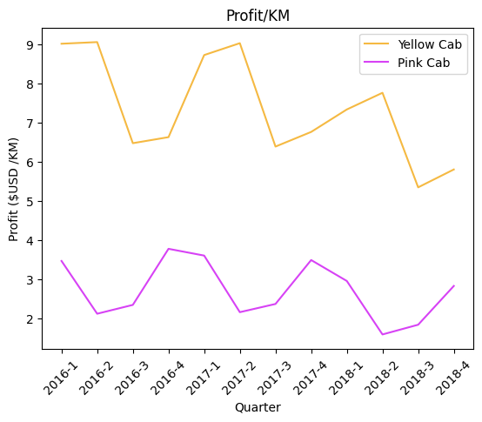
Profits / KM
Yellow cab maintains higher profits per KM (quarter- mean=$7.37 vs $2.71) and the trend in profits/KM coincides with both company's quarterly profit margins. Both companies are experienced lower profits/KM in 2018.

Slide 21
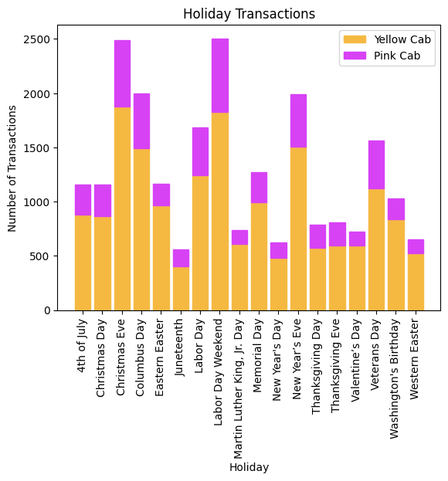
Transactions on Holiday
Yellow cab outperforms in transactions on holidays.

Slide 22
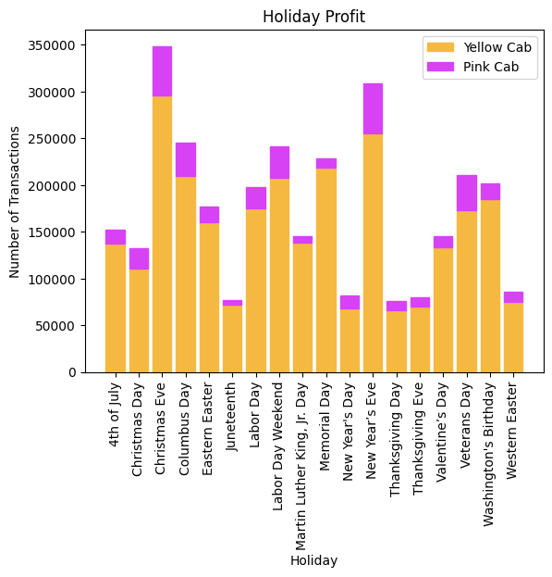
Profits on Holiday
Yellow cab outperforms in profit on holidays.

Slide 23
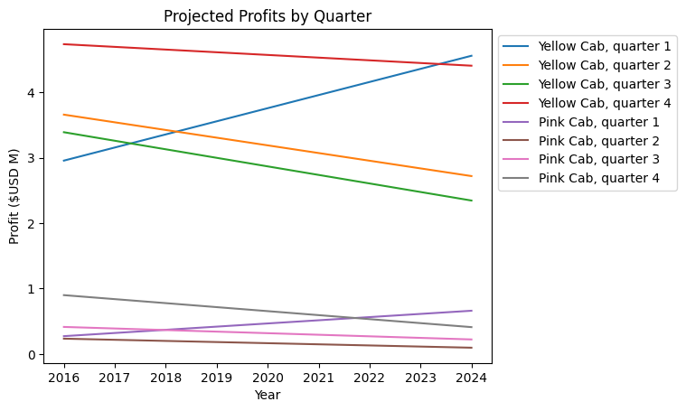
Quarterly Projected Profits
Linear forecasting reveals per each quarter, the yellow cab will achieve a greater profit in the upcoming years.

Slide 24
The Yellow cab Presents the better investment opportunity
According to the data presented here, the yellow cab has generated and is projected to generate substantially more profit than the pink cab
The yellow cab is preferred among the population across all the features analyzed, and in cities where the pink cab preference is comparable the profits/cab usage are not nearly as high as the cities that prefer the yellow cab.
Profit margins reveal the yellow cab to be an investment with higher returns.
Thankyou.

